Slide 1
TM performance: seeing the whole picture or Looking back over the first 500 papers
Tim Harris (MSR Cambridge)

Slide 2
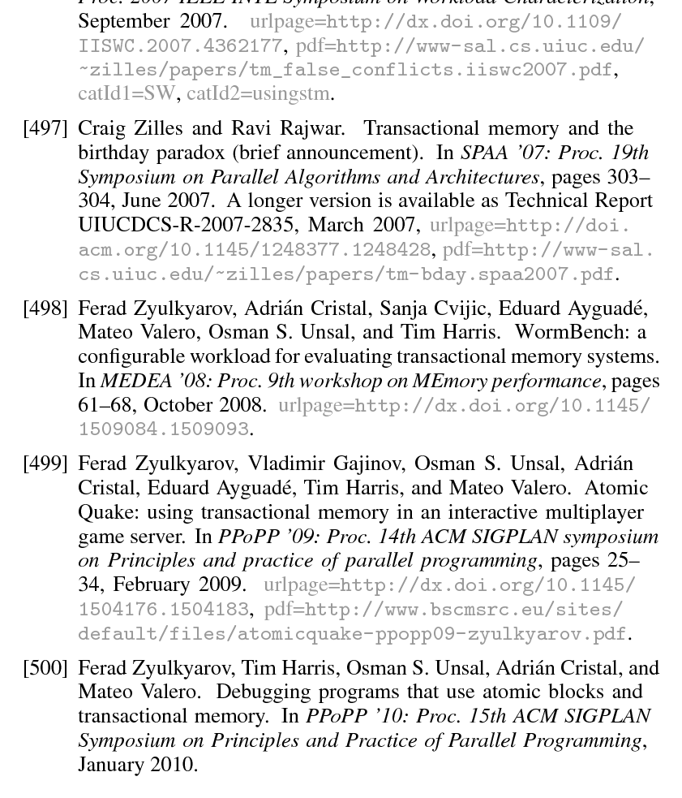

Slide 3
How might we compare TM systems?
Where might TM be most useful?

Slide 4
Extending Dan’s GC analogy
“Here’s a way to reduce the pause times...”
C
Concurrent GC algorithm (run GC in small steps in amongst mutators)
A
B
“Here’s a way to improve the throughput (total app runtime)...
“Here’s a way to support pinned objects...”

Slide 5
Min mutator utilization

Slide 6
Five dimensions to TM behavior
Sequential overhead
Scalability
(to more cores)
Semantics
Scalability (to longer transactions)
Tx-supported operations

Slide 7
Scaling to large transactions
1.0 = optimized sequential code
(no tx, no locks)

Slide 8
Scaling: n*1-core copies
1.0 = optimized sequential code
(no tx, no locks)

Slide 9
Scaling: 1*n-core copy
1.0 = optimized sequential code
(no tx, no locks)

Slide 10
How might we compare TM systems?
Where might TM be most useful?

Slide 11
Application model #1
Sequential
Parallelizable
f = fraction of original program that is parallelizable

Slide 12
Application model #1
Parallel
Parallel
Sequential
...
Parallel
f = fraction of original program that is parallelizable
n = num parallel threads

Slide 13
Application model #1
Parallel, transactional
Parallel, transactional
Sequential
...
Parallel, transactional
f = fraction of original program that is parallelizable
n = num parallel threads
x = straight-line transactional slow-down

Slide 14
Conflict model
Execute
conflicting
operations
in series
1
2
3
4
5
6
Fixed number of alternatives, execute different alternatives in parallel
f = fraction of original program that is parallelizable
n = num parallel threads
x = straight-line transactional slow-down
c = mean number of attempts per transaction (1 => no conflicts)

Slide 15
n=16, c=1.0, vary f, vary x
f = fraction of original program that is parallelizable
n = num parallel threads
x = straight-line transactional slow-down
c = mean number of attempts per transaction (1 => no conflicts)

Slide 16
n=16, c=1.0
8x on 16 threads => 95% parallelizable
f = fraction of original program that is parallelizable
n = num parallel threads
x = straight-line transactional slow-down
c = mean number of attempts per transaction (1 => no conflicts)

Slide 17
n=16, c=1.0
Straight-line slow-down bites quickly
f = fraction of original program that is parallelizable
n = num parallel threads
x = straight-line transactional slow-down
c = mean number of attempts per transaction (1 => no conflicts)

Slide 18
n=16, c=1.1 (1..1024)
f = fraction of original program that is parallelizable
n = num parallel threads
x = straight-line transactional slow-down
c = mean number of attempts per transaction (1 => no conflicts)

Slide 19
n=16, c=1.4 (1..256)
f = fraction of original program that is parallelizable
n = num parallel threads
x = straight-line transactional slow-down
c = mean number of attempts per transaction (1 => no conflicts)

Slide 20
n=16, c=2.0 (1..64)
f = fraction of original program that is parallelizable
n = num parallel threads
x = straight-line transactional slow-down
c = mean number of attempts per transaction (1 => no conflicts)

Slide 21
n=16, c=3.1 (1..16)
If Amdahl and overheads don’t get you then conflicts still can...
f = fraction of original program that is parallelizable
n = num parallel threads
x = straight-line transactional slow-down
c = mean number of attempts per transaction (1 => no conflicts)

Slide 22
n=16, c=1.0, scaling of large tx
f = fraction of original program that is parallelizable
n = num parallel threads
x = straight-line transactional slow-down
c = mean number of attempts per transaction (1 => no conflicts)

Slide 23
n=16, c=1.0, x*(f+(f^1.25)/4)
f = fraction of original program that is parallelizable
n = num parallel threads
x = straight-line transactional slow-down
c = mean number of attempts per transaction (1 => no conflicts)

Slide 24
n=16, c=1.0, x*(f+(f^2)/4)
f = fraction of original program that is parallelizable
n = num parallel threads
x = straight-line transactional slow-down
c = mean number of attempts per transaction (1 => no conflicts)

Slide 25
Application model #2: 100% parallel
Tx
Non-tx
Tx
Non-tx
...
Tx
Non-tx
t = fraction of original program that is transactional
n = num parallel threads
x = straight-line transactional slow-down
c = mean number of attempts per transaction (1 => no conflicts)

Slide 26
Workloads (ASPLOS ’10)
JBBAtomic
Labyrinth
Vacation
Genome
MaxFlow
t = fraction of original program that is transactional
n = num parallel threads
x = straight-line transactional slow-down
c = mean number of attempts per transaction (1 => no conflicts)

Slide 27
Workloads (ASPLOS ’10)
JBBAtomic
Labyrinth
Vacation
Genome
MaxFlow
t = fraction of original program that is transactional
n = num parallel threads
x = straight-line transactional slow-down
c = mean number of attempts per transaction (1 => no conflicts)

Slide 28
n=16, c=1.0 (no conflicts)
t = fraction of original program that is transactional
n = num parallel threads
x = straight-line transactional slow-down
c = mean number of attempts per transaction (1 => no conflicts)

Slide 29
n=16, c=1.0 (no conflicts)
Overheads rapidly reduce the amount that transactions can be used
t = fraction of original program that is transactional
n = num parallel threads
x = straight-line transactional slow-down
c = mean number of attempts per transaction (1 => no conflicts)

Slide 30
n=16, c=1.1 (1..1024)
t = fraction of original program that is transactional
n = num parallel threads
x = straight-line transactional slow-down
c = mean number of attempts per transaction (1 => no conflicts)

Slide 31
n=16, c=1.4 (1..256)
t = fraction of original program that is transactional
n = num parallel threads
x = straight-line transactional slow-down
c = mean number of attempts per transaction (1 => no conflicts)

Slide 32
n=16, c=2.0 (1..64)
t = fraction of original program that is transactional
n = num parallel threads
x = straight-line transactional slow-down
c = mean number of attempts per transaction (1 => no conflicts)

Slide 33
Conclusions
Bad things come in threes...
Amdahl’s law
Sequential overhead
Conflicts
When developing TM systems we need to be careful about tradeoffs between these
There’s a risk of “chasing around the TM design space”
Sequential overhead
Scaling without conflicts
Scaling with conflicts

